Slide 1
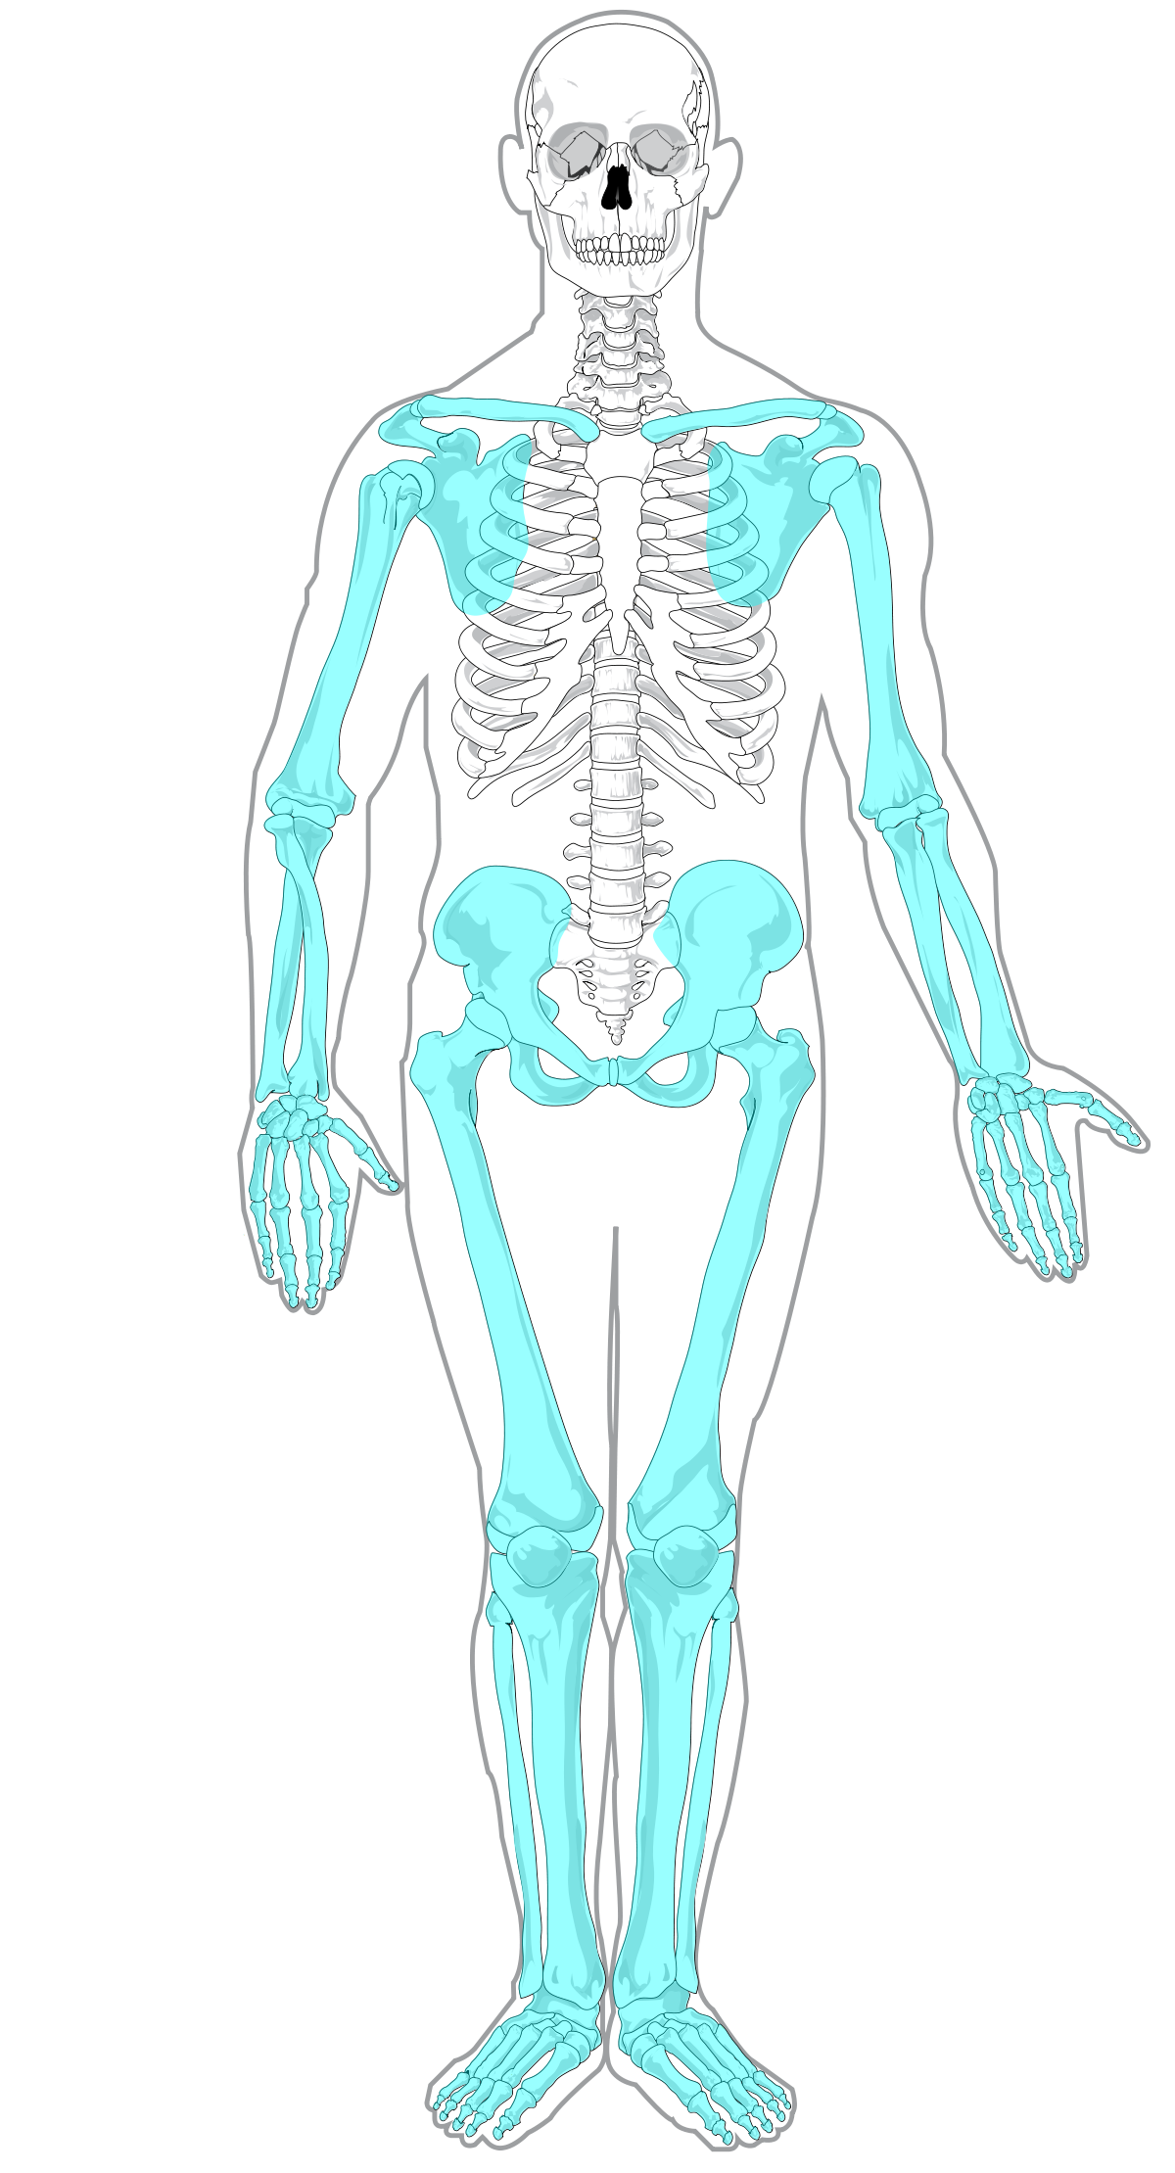
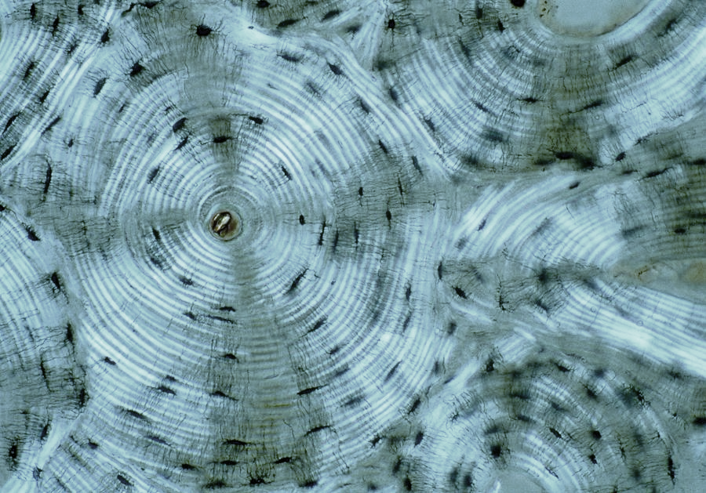
Chapter 8: Appendicular Skeleton
image: compact bone
Dr. Paige Morgan Laramie County Community College

Slide 2
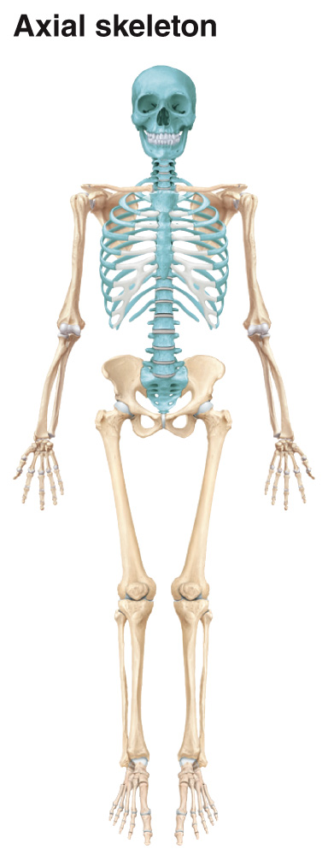
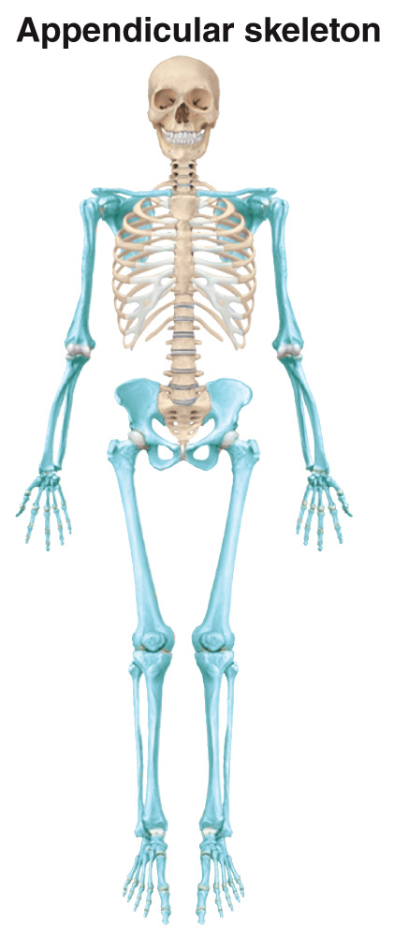
Axial vs. Appendicular Skeleton
axial skeleton: consists of the bones that lie around the longitudinal axis of the body
appendicular skeleton: consists of bones of the upper and lower limbs + the bones forming the girdles, connecting limbs to the axial skeleton
2

Slide 3
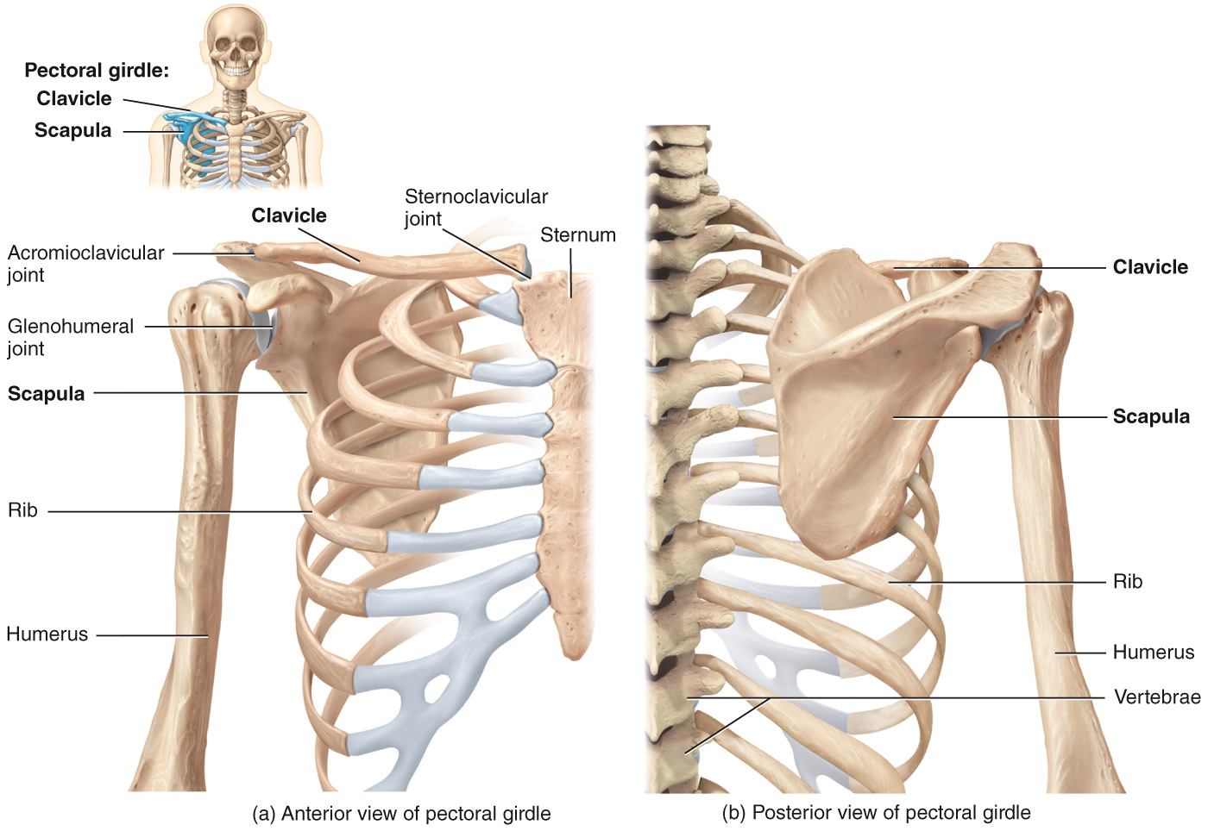
Pectoral Girdle
pectoral girdle: attaches the bones of the upper limbs to the axial skeleton; consists of: [1] clavicle aka “collar bone” [2] scapula aka “shoulder”
3

Slide 4
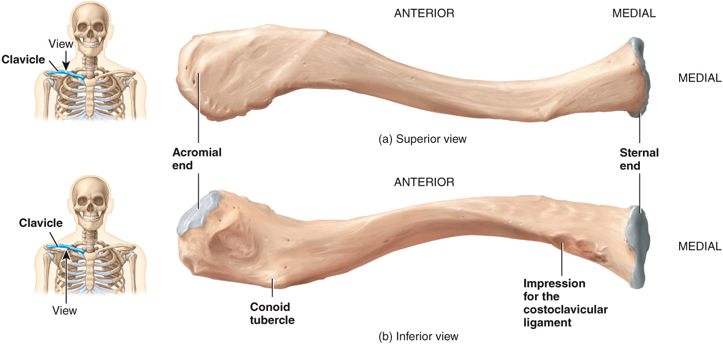
Pectoral Girdle – Clavicle
articulates with the acromion of the scapula at the acromioclavicular joint
articulates with the manubrium at the sternoclavicular joint
point of attachment for conoid ligament (attaches scapula and clavicle)
point of attachment for costoclavicular ligament (attaches clavicle and 1st rib)
4

Slide 5
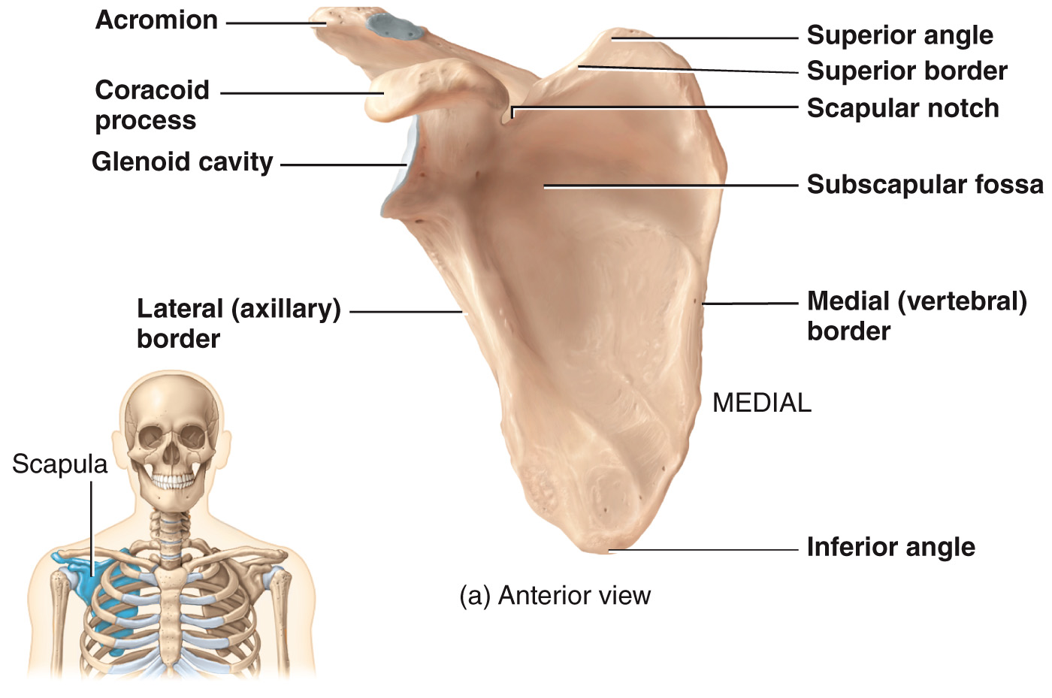
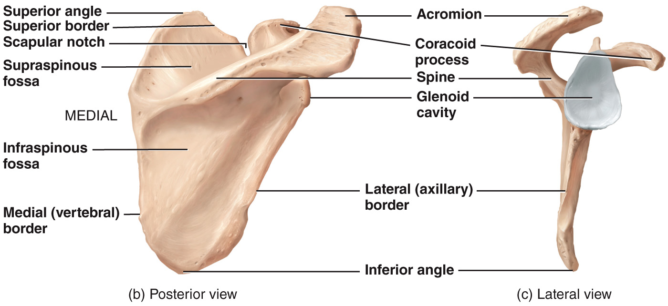
Pectoral Girdle – Scapula
[1] acromion: flattened, expanded process forming the high point of the shoulder
[2] glenoid cavity: accepts the head of the humerus to form glenohumeral (shoulder) joint
[3] coracoid process: small hook-like process on the lateral edge of the superior portion of the scapula
[4] spine: prominent ridge that runs diagonally across the posterior surface
5

Slide 6
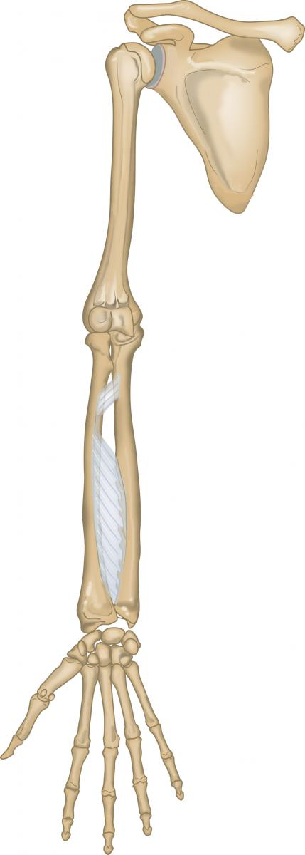
Upper Limb
upper limb: each upper limb has 30 bones in 3 locations [1] the humerus [2] the ulna and radius [3] the 8 carpals in the carpus (wrist) 5 metacarpals (palm) 14 phalanges (fingers)
humerus
radius
ulna
carpals
metacarpals
phalanges
6

Slide 7
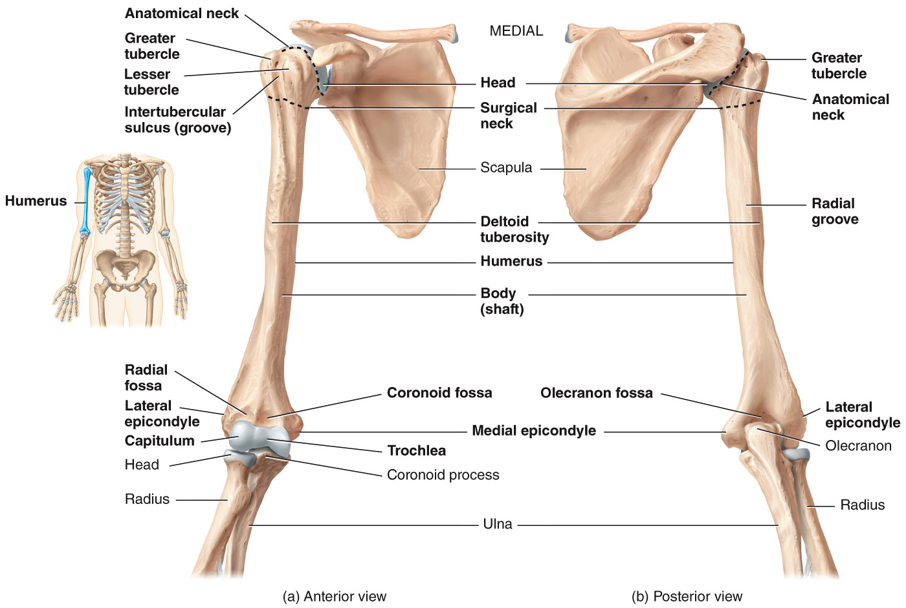
Upper Limb – Humerus
humerus: largest, longest bone of the upper limb
attachment point for tendons of deltoid muscle
projections around the intertubercular sulcus
accommodates tendon for biceps brachii
accommodates radial nerve
large posterior depression
anterior depression
anterior depression
articulates with head of radius
articulates with trochlear notch of ulna
7

Slide 8
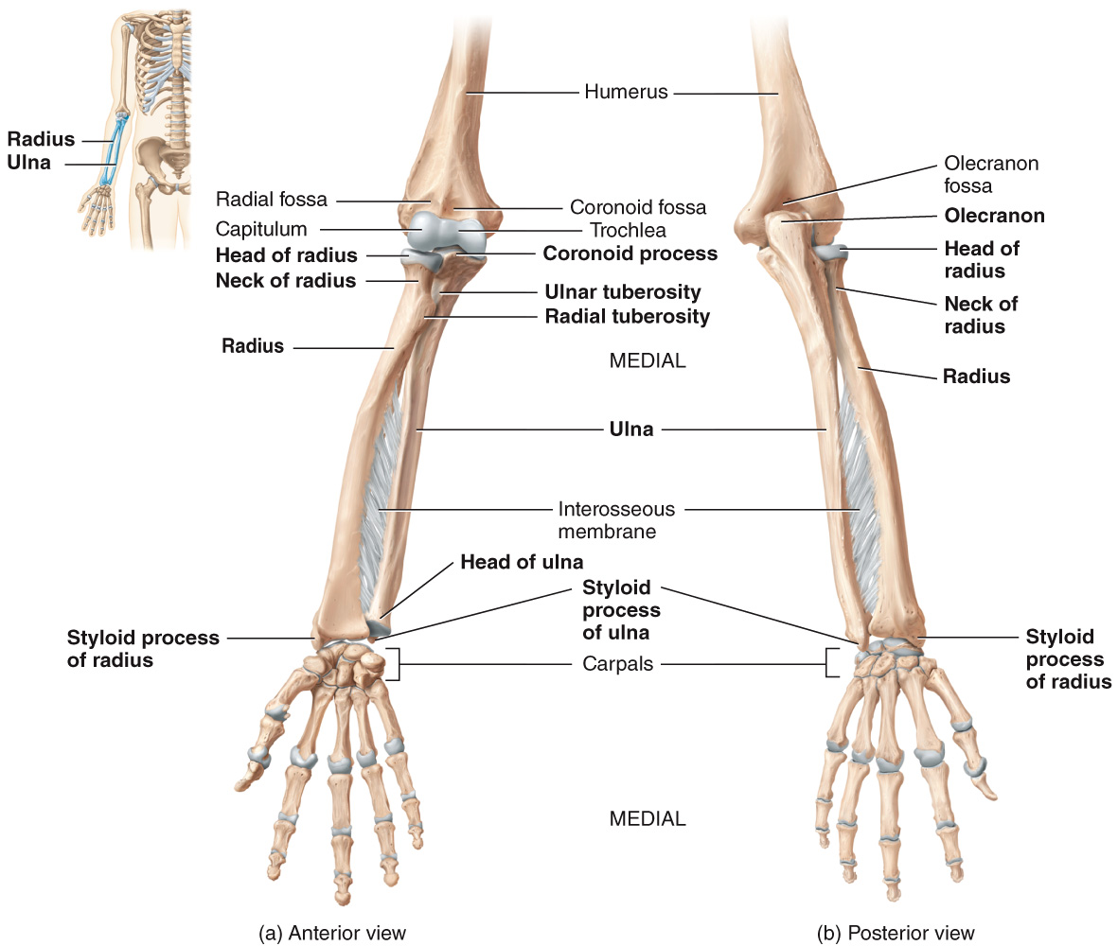
Upper Limb – Ulna
ulna: medial aspect of the forearm; p.u. = pinky is on the ulna side
forms the posterior prominence of the elbow
articulates with
trochlea of the humerus
attachment for ulnar collateral ligament to the wrist
attachment point for biceps brachii muscle
8

Slide 9
Upper Limb – Radius
radius: located on the lateral aspect of the forearm
attachment point for biceps brachii muscle
membrane (connective tissue) that holds the radius and ulna together
9

Slide 10
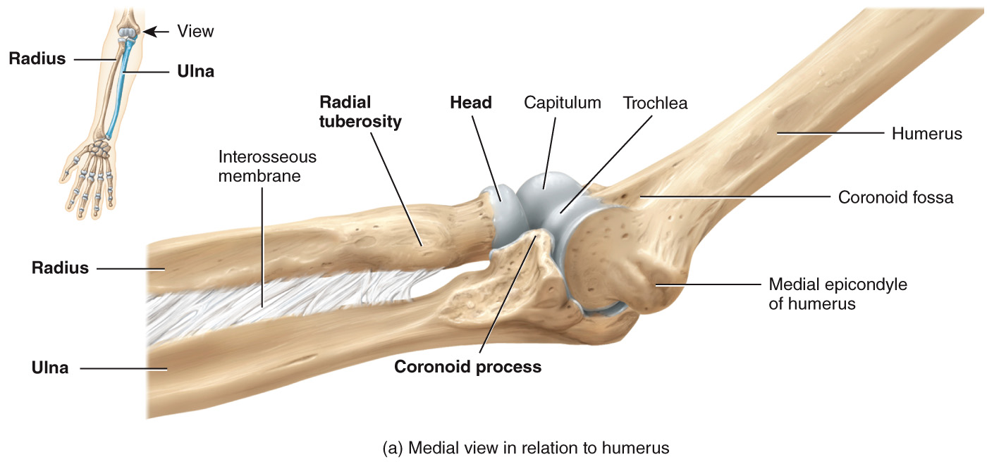
Upper Limb – Elbow Joint
radius and ulna articulate with humerus at the elbow joint; occurs in two places: [1] where head of radius articulates with the capitulum of the humerus [2] where the coronoid process of the ulna articulates with the trochlea of the humerus
capitulum (articular cartilage)
trochlea (articular cartilage)
head of radius (radius)
coronoid process (ulna)
10

Slide 11
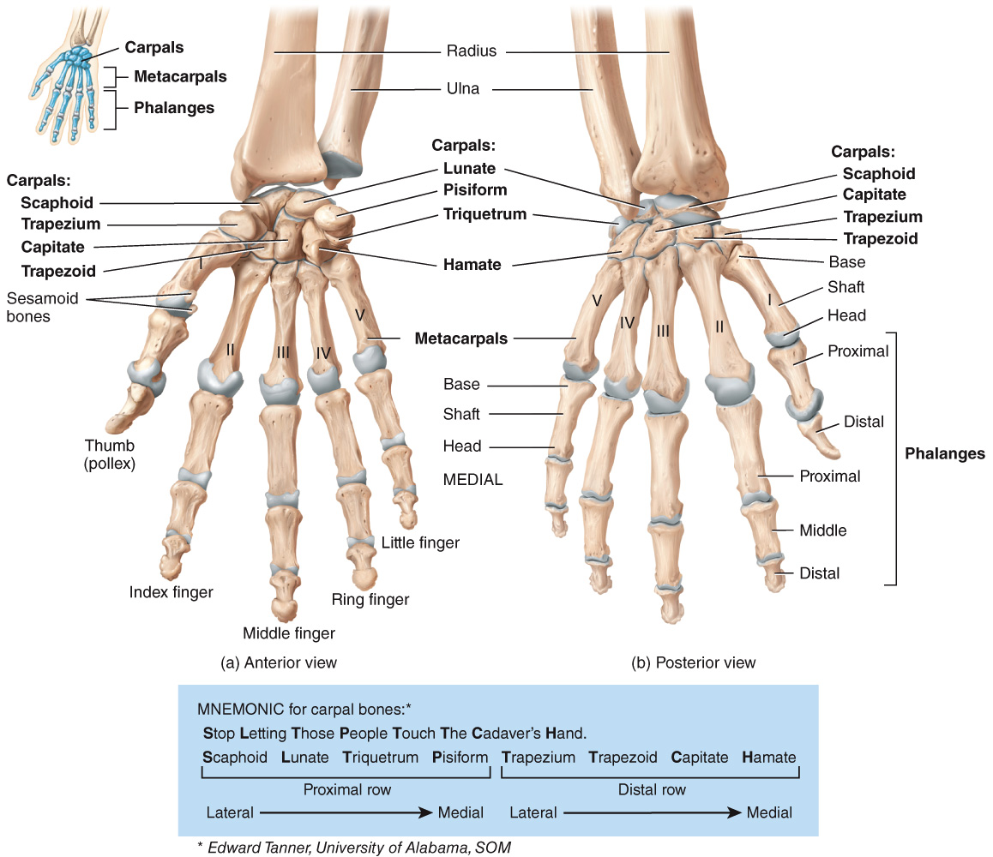
Upper Limb – Carpals
carpals: 8 small bones of the wrist joined to one another with ligaments
11

Slide 12
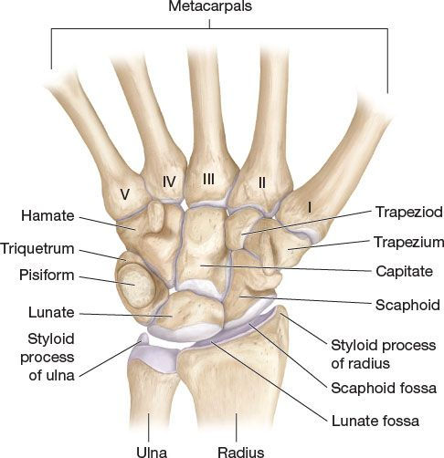
Upper Limb – Carpals
carpals: 8 small bones of the wrist joined to one another with ligaments
carpals in the proximal row: 1. scaphoid (boat-like) 2. lunate (moon-shaped) 3. triquetrum (tree-cornered) 4. pisiform (pea-shaped)
carpals in the distal row: 1. trapezium (4-sided figure with no 2 sides parallel) 2. trapezoid (4-sided figure with 2 sides parallel) 3. capitate (head-shaped) 4. hamate (hooked)
(medial side) PINKY
THUMB (lateral side)
*note: diagram is NOT in anatomical position*
12

Slide 13
Upper Limb – Carpals
trapezium = base of the thumb
trapezoid = base of the index finger
capitate = base of the middle finger
hamate = base of ring finger + pinky
scaphoid = “under” the traps
lunate = base of carpus (wrist)
triquetrum = underneath the pisiform
pisiform = pea-shaped bone that sits on the triquetrum
*note: diagram is NOT in anatomical position*
13

Slide 14
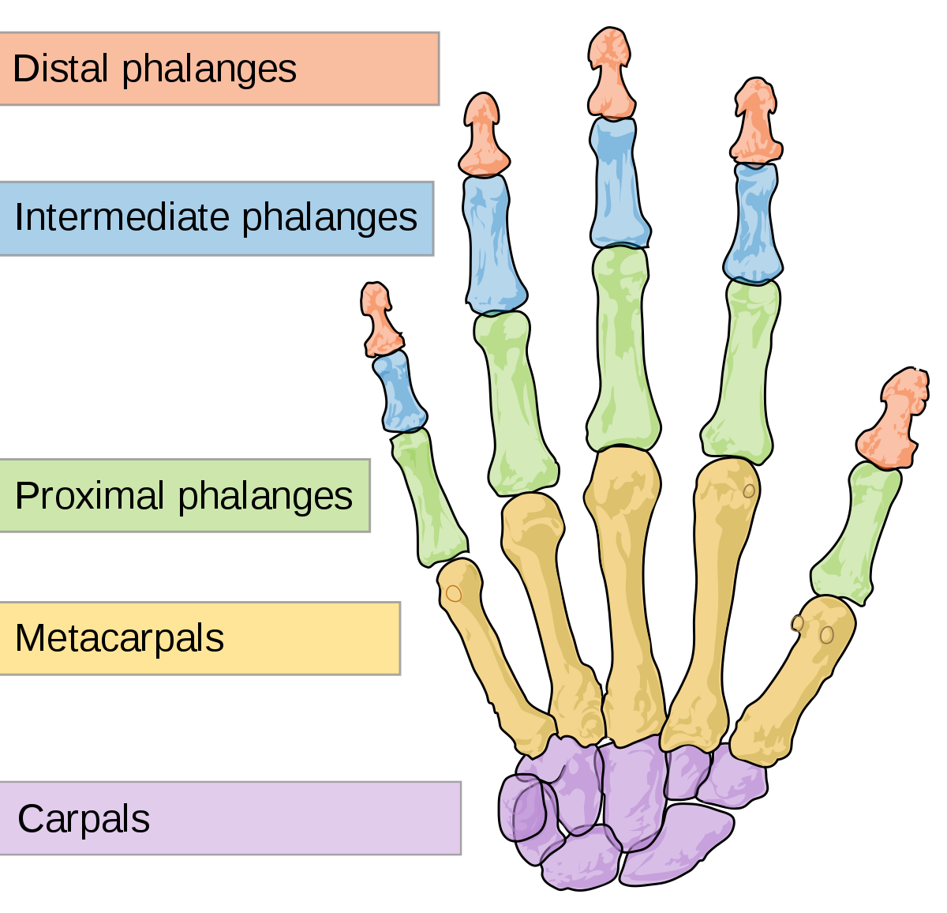
Upper Limb – Metacarpals and Phalanges
metacarpals: 5 bones of the intermediate region of the hand → numbered 1-5, starting with the thumb, from lateral to medial
phalanges: bones of the digits → most digits have 3 phalanges: proximal, intermediate/middle, and distal → thumb is missing the middle phalange
3
4
2
5
1
*note: diagram is NOT in anatomical position*
14

Slide 15
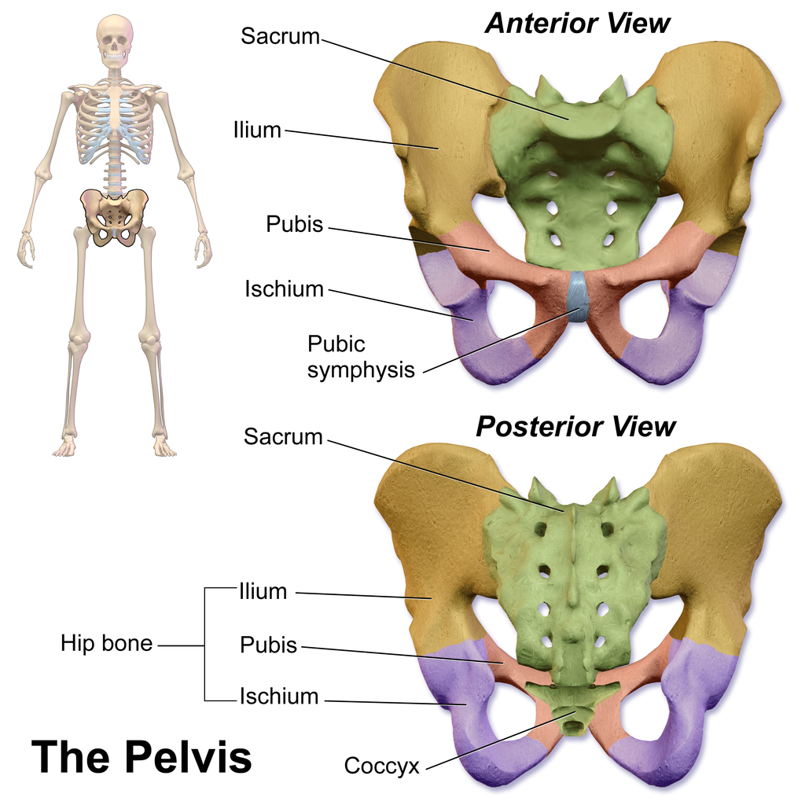
Pelvic Girdle
pelvic girdle: consists of 2 hip bones and the sacrum (part of the vertebral column), joined by: → pubic symphysis: cartilaginous joint where the 2 hip bones join anteriorly
→ sacroiliac joint: synovial joint where 2 hip bones meet the sacrum posteriorly
15

Slide 16
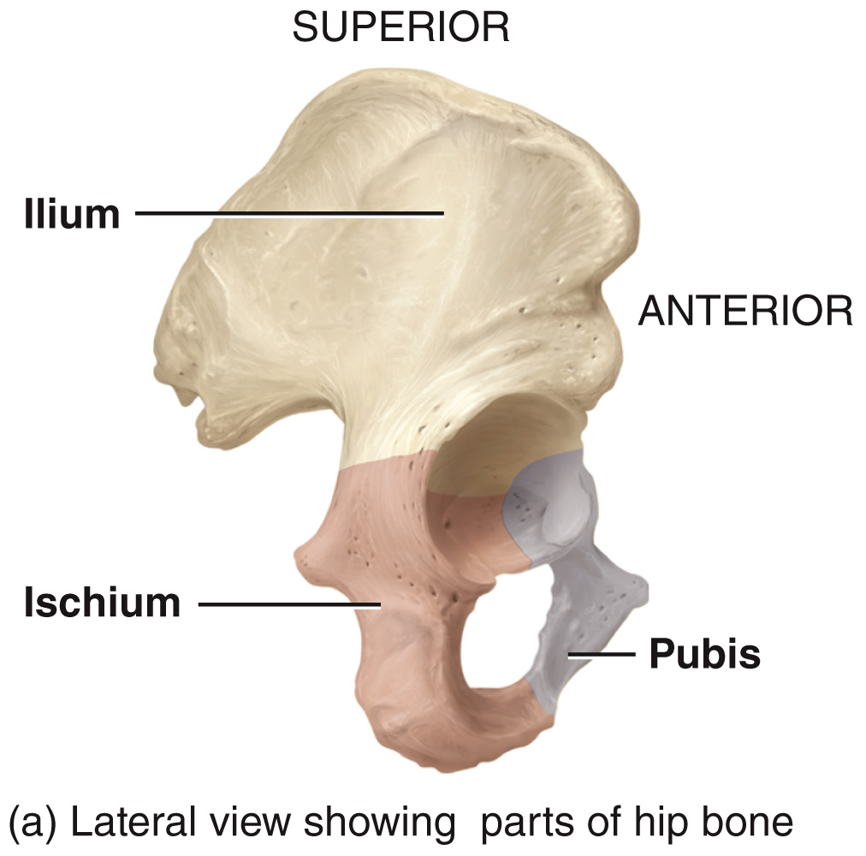
Pelvic Girdle – Hip Bones
hip bone: consists of the ilium, ischium, and pubis (fused by age 15-17 yrs)
ileum: largest and most superior of the 3 components of the hip bone
ischium: inferior and lateral portion of the hip bone
pubis: inferior and medial portion of the hip bone
16

Slide 17
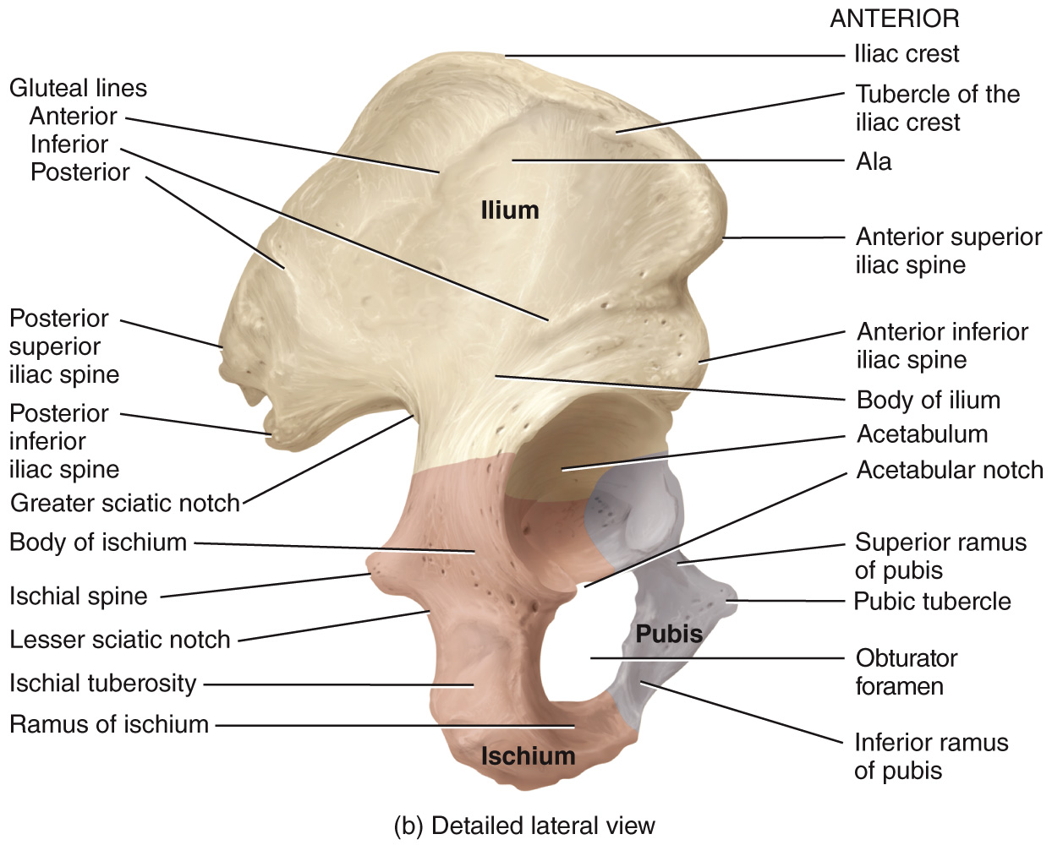
Pelvic Girdle – Hip Bones
hip bone: consists of the ilium, ischium, and pubis (fused by age 15-17 yrs)
superior border of the ilium
articulates with head of femur
accommodates nerves and blood vessels
17

Slide 18
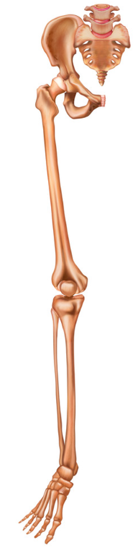
Lower Limb
lower limb: consists of 30 bones in 4 locations: [1] the femur [2] the patella (kneecap) [3] the tibia and fibula [4] the 7 tarsals in the tarsus (ankle) 5 metatarsals 14 phalanges
femur
patella
fibula
tibia
tarsals
metatarsals
phalanges
18

Slide 19
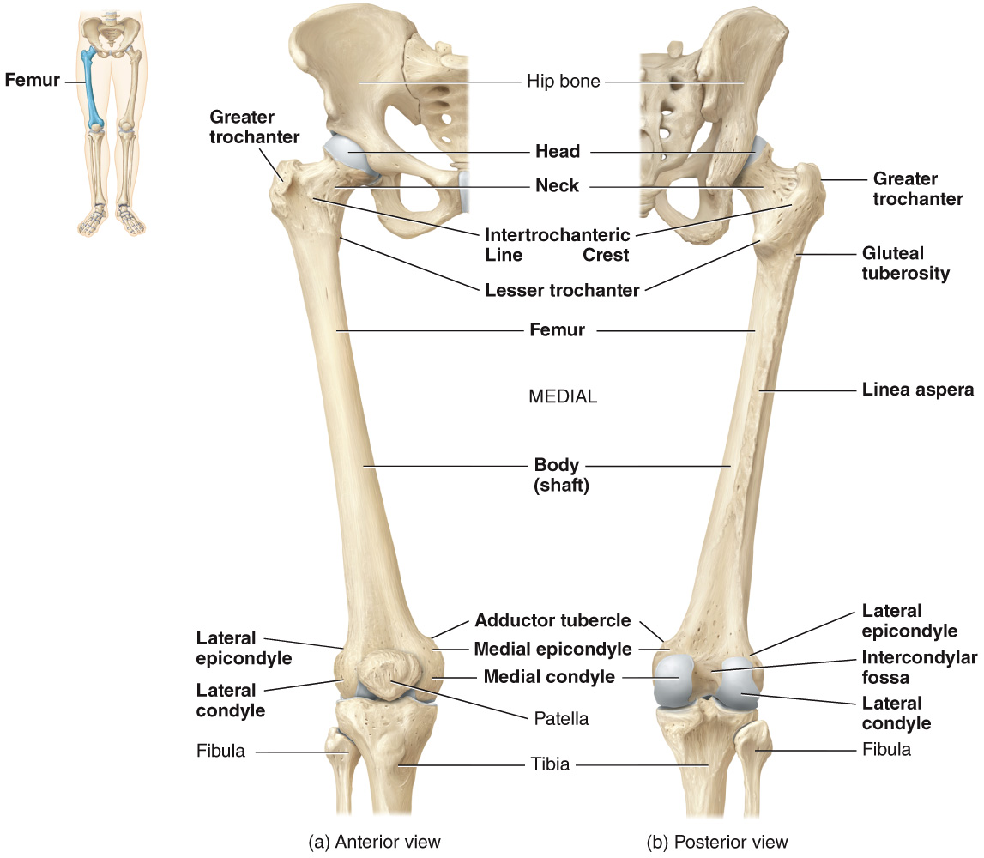
Lower Limb – Femur
femur: longest, heaviest, strongest bone in the body
articulates with acetabulum of the hip
projection that serves as attachment point for tendons of thigh and buttock muscles
projection that serves as attachment point for tendons of thigh and buttock muscles (more visible on posterior side)
attachment points for tendons of several thigh muscles
articulate with the medial/lateral condyles of the tibia
19

Slide 20
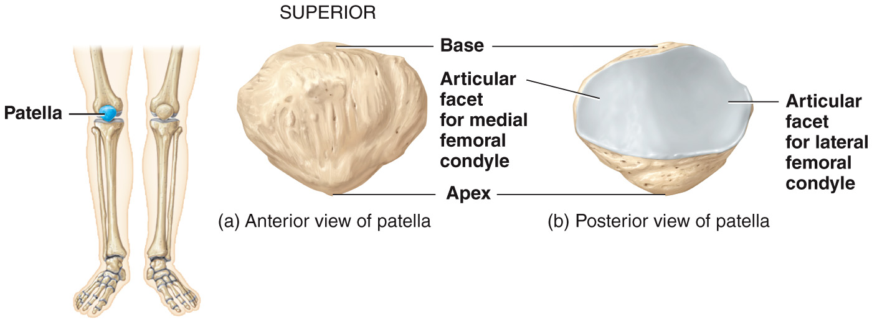
Lower Limb – Patella
patella: small, triangular bone located anterior to the knee joint
20

Slide 21
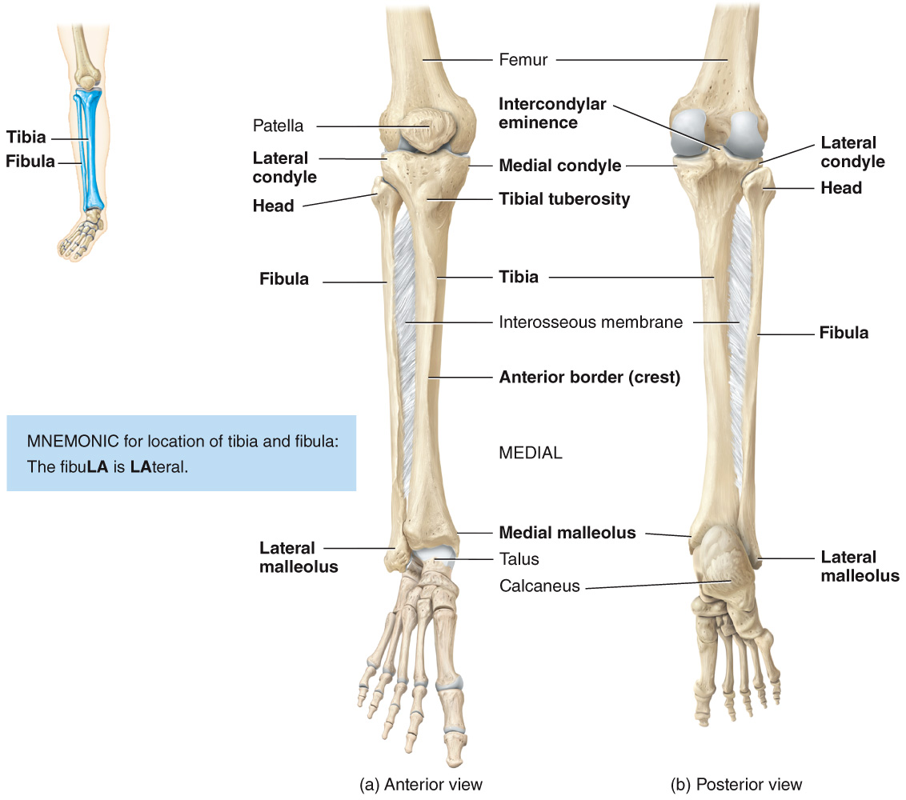
Lower Limb – Tibia
tibia: (aka shin bone) is the larger, medial weight-bearing bone of the lower leg
articulate with condyles of the femur to form tibiofemoral (knee) joint
attachment point for the patellar ligament (visible only on anterior side)
connects tibia and fibula
articulates with the talus (of the ankle) and forms the prominence that can be felt on the medial surface of the ankle
21

Slide 22
Lower Limb – Fibula
fibula: parallel and lateral to the tibia but considerably smaller → unlike the tibia, it does NOT articulate with the femur but it does help stabilize the ankle joint
forms the prominence that can be felt on the lateral surface of the ankle
22

Slide 23
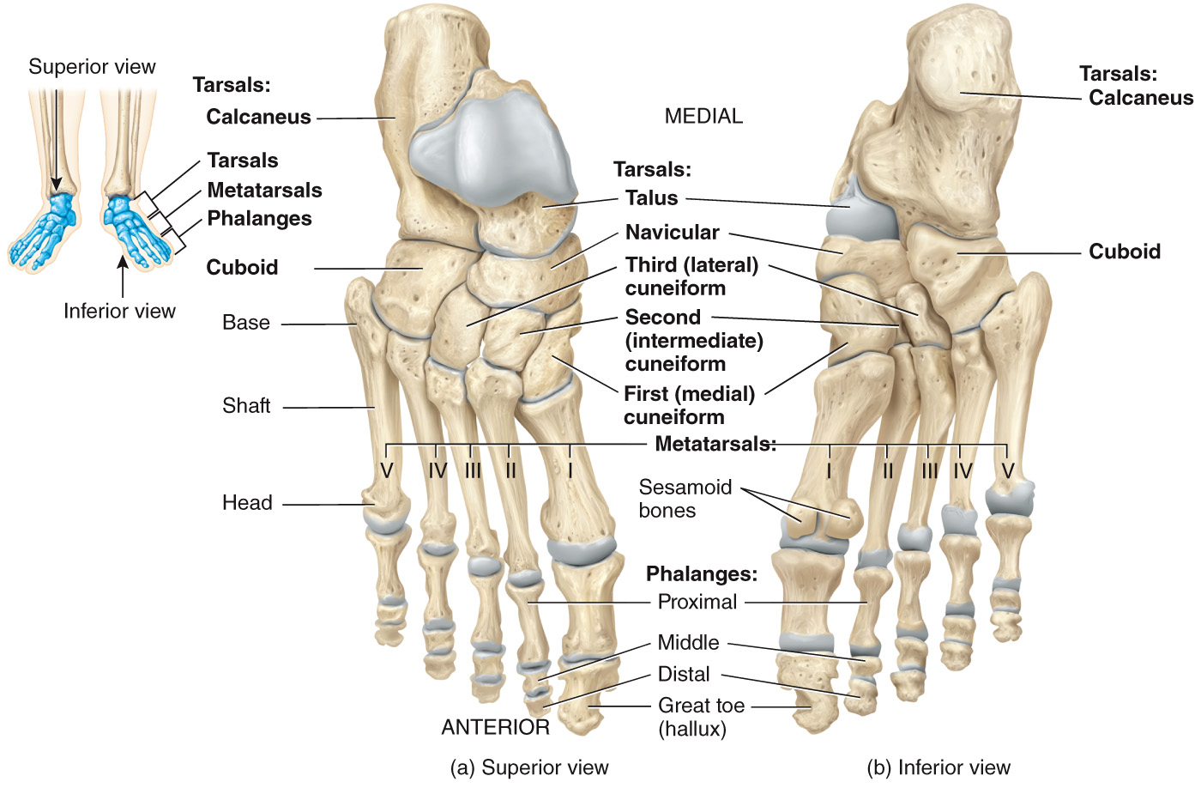
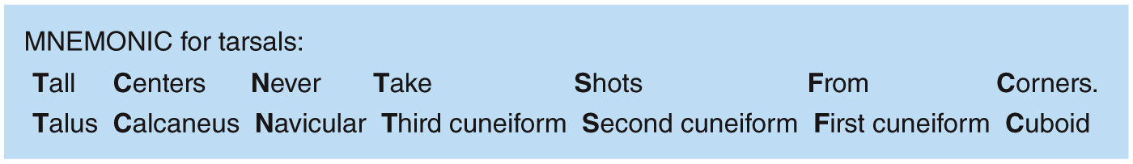
Lower Limb – Tarsals
tarsals: 7 bones of the tarsus
23

Slide 24
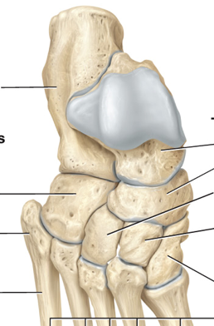
Lower Limb – Tarsals
tarsals: 7 bones of the tarsus
calcaneus: heel bone
cuboid: “behind” the pinky toe, in “front” of heel
cuneiforms I, II, III: “behind” digits 1-3
navicular: “behind” the cuneiforms
talus: opposite the heel
3
2
1
24

Slide 25
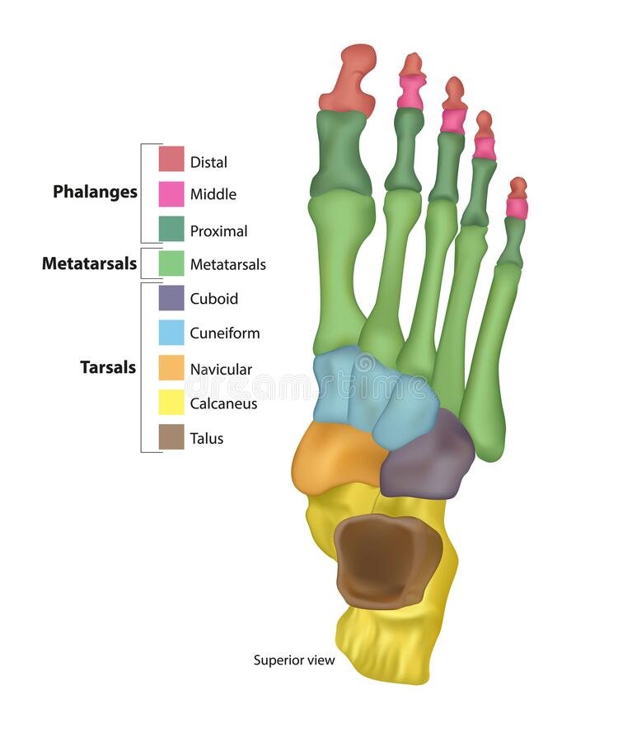
Upper Limb – Metatarsals and Phalanges
metacarpals: 5 bones of the intermediate region of the foot → numbered 1-5, starting with the big toe (hallux), from medial to lateral
phalanges: bones of the digits → most digits have 3 phalanges: proximal, intermediate/middle, and distal phalanges → hallux is missing the middle phalange
1
2
3
4
5
25

Slide 26
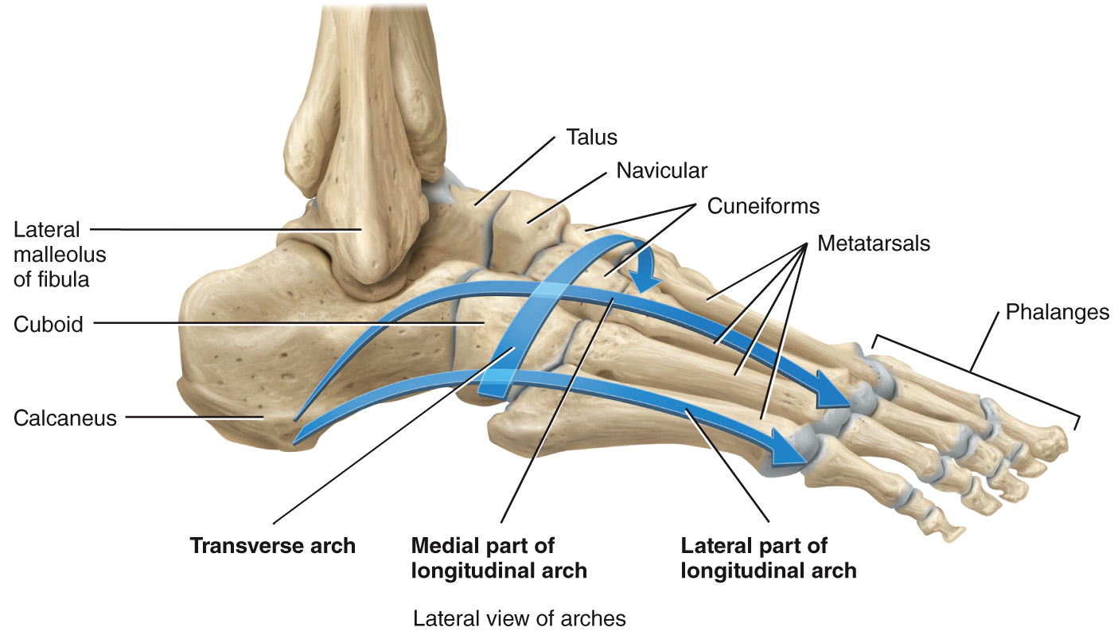
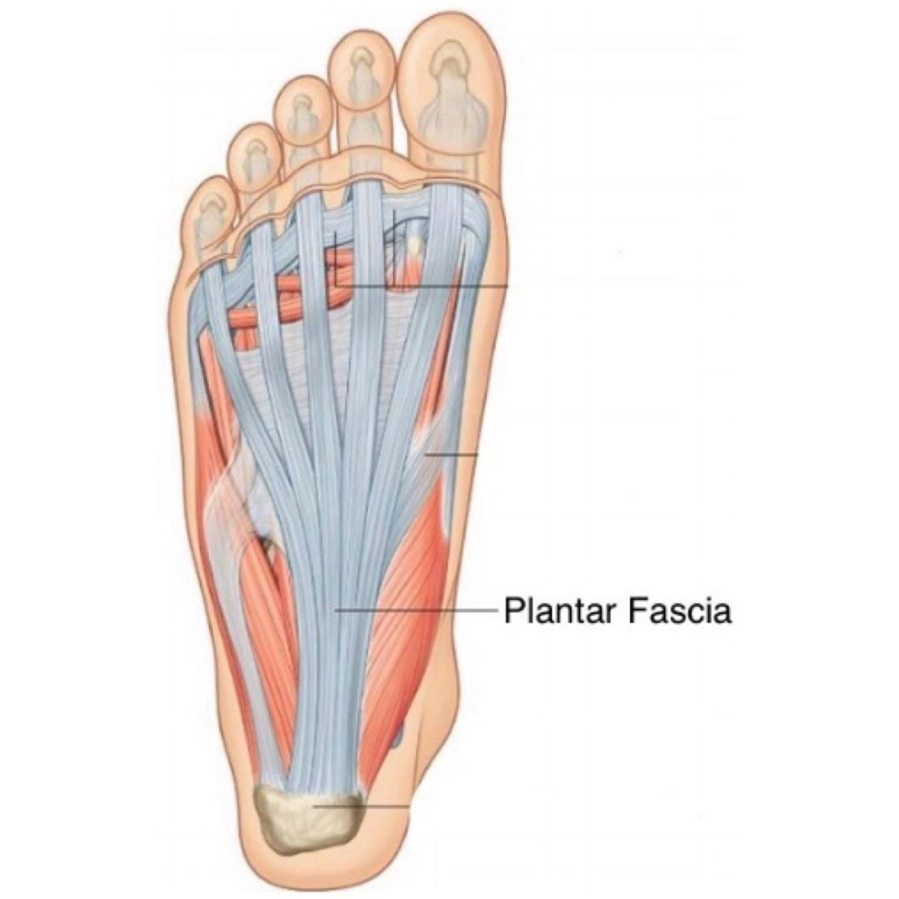
Upper Limb – Arches of the Foot
arches: held together in position by ligaments and tendons → plantar fascia: think connective tissue (aponeurosis) which supports the arches
enable the foot to support the weight of the body and provide leverage while walking
ball of foot carries 40% of weight, heel carries about 60% of weight
26

Slide 27
Watch These Videos:
Videos from the textbook:
Pectoral (shoulder) girdle
The Pelvic Girdle

